Slide 1
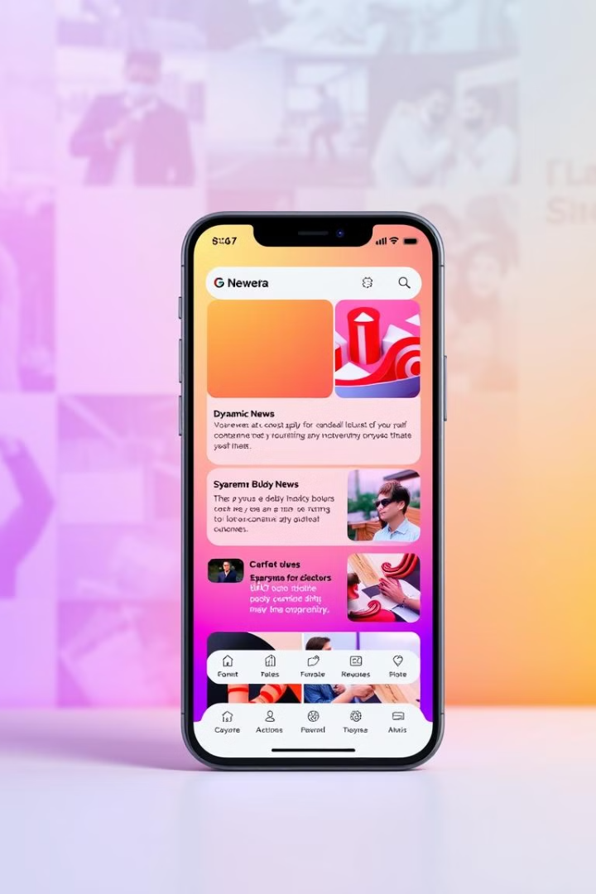
NewsFlash:
A Modern News Platform
Presented by:
Chopade Pavankumar
Patil Rutu
Rokade Kunal
Vadhawakar Tanishka

Slide 2
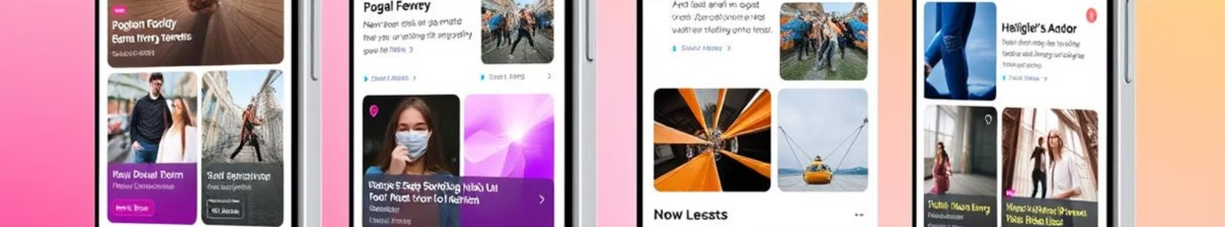



Project Overview: Reimagining News Delivery
NewsFlash is a React-based news platform. It's designed for speed and accessibility.
Key features include categorized news feeds and infinite scrolling. It also uses dynamic data fetching from multiple sources.
The target audience is news consumers. They seek efficient and personalized information.
Fast
Accessible
Personalized
Optimized for speed
Designed for accessibility
Provides personalized information

Slide 3
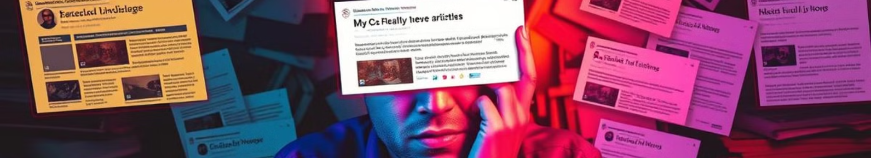
The Problem: News Consumption Challenges
Users struggle to find relevant news quickly due to information overload.
Traditional news sites suffer from performance issues. The average load time for news websites is 5.9 seconds on desktop and 12.8 seconds on mobile in 2023.
There's difficulty filtering news by specific interests, with only 35% of news websites offering advanced categorization options.
1
Information Overload
2
Slow Loading Times
3
Lack of Categorization
Relevant news is hard to find.
Performance issues on traditional sites.
Filtering by interest is difficult.

Slide 4

The Solution: Fast, Focused, and User-Friendly
NewsFlash addresses these issues through optimized performance.
Intelligent categorization enables easy filtering. A clean, intuitive interface with infinite scrolling provides continuous content discovery.
NewsFlash uses dynamic data fetching that updates frequently from diverse sources.
Optimized Performance
Intelligent Categorization
Seamless UX
Lightning-fast loading times.
Easily filter content.
Clean, intuitive interface.

Slide 5
Core Features:
NewsFlash has categorized news feeds.
You can easily browse news by topic of interest.
It features infinite scrolling.
Effortlessly discover articles without page reloads.
Real-time updates from reputable news APIs, with responsive design for seamless viewing on all devices.
Categorized News
Infinite Scrolling
Responsive Design
Browse by topic.
Effortless discovery.
Optimized for all devices.

Slide 6



Technical Architecture: Scalability and Performance
NewsFlash utilizes a React Frontend for efficient UI development.
News data is fetched from NewsAPI.
React Frontend
News APIs

